Slide 1
HOTEL AGGREGATOR ANALYSIS WITH POWER BI
A PRESENTATION ON

Slide 2
PROBLEM STATEMENT
This internship project aims to analyze a dataset of hotel aggregator listings using Power BI.
The dataset comprises various attributes related to listings, hosts, reviews, and availability.
The objective is to create comprehensive visualizations and insights that shed light on trends, patterns, and factors influencing the performance of listings.
Through Power BI, interns will explore key metrics such as pricing, availability, host characteristics, and review scores to derive actionable insights for improving the overall quality and competitiveness of the listings

Slide 3
DATASET DESCRIPTION
id: Unique identifier for each listing.
listing_url: URL of the listing on the hotel aggregator platform.
scrape_id: Identifier for the data scraping event.
last_scraped: Date of the last data scrape.
source: Source of the listing information.
name: Name of the listing.
description: Description of the listing.
neighborhood_overview: Overview of the neighborhood where the listing is located.
picture_url: URL of the listing's picture.
host_id: Unique identifier for the host.
. ... (and many more columns capturing details about hosts, location, property type, room details, amenities, pricing, availability, reviews, and other relevant information)

Slide 4
PROJECT OBJECTIVES:

Slide 5
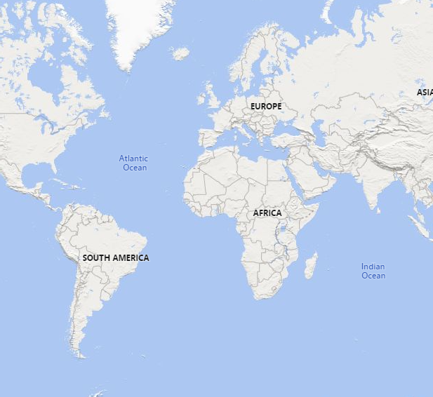
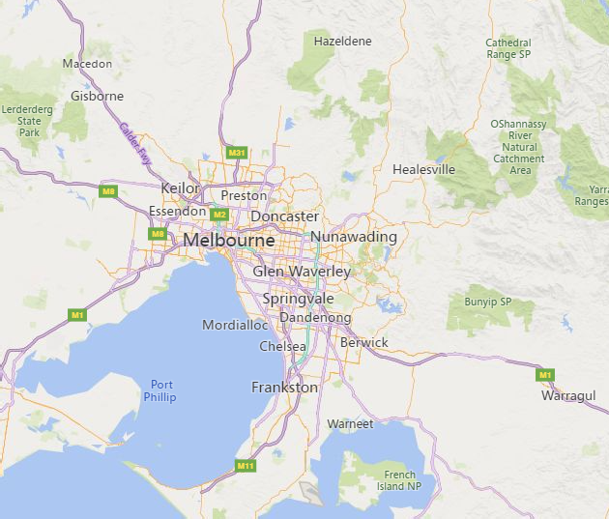









GEOGRAPHICAL INSIGHTS
Power BI Desktop
neighbourhood, latitude and longitude
neighbourhood Abbotsfor… Aberfeldi…
host_location
Airport …
Albanval…
Albert Par…
Albion, …
© 2024 Miiccrrossofftt Corrporrattiion
© 22002244 Miiccrroossoofftt Coorrppoorraattiioonn

Slide 6
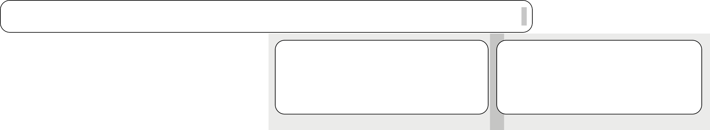
PRICING AND AVAILABILTY ANALYSIS
Power BI Desktop
avg pricing based on accommodation capacity
$755.2553
avg price
number of instant bookable
$231.1671 2
avg pricing based on property type
$566.7404
$563.6384
$566.5816
Average of price
$473.1429
$459.0473
$442.7857
$10K
$161.9623
$8K
$93.8683
Average of price
$6K
0
5
accommodates
10
15
avg pricing based on room type
$4K
$261.6096
$2K
Entire home/apt
room_type
Hotel room
$243.191
$0K
Casa particular
Holiday park Private room in villa
Entire loft Entire home/apt
Entire villa
Tower Castle Yurt
Shipping container
Farm stay Private room in nat…
Train Entire home
Entire bed and brea… Room in nature lodge
Entire chalet Entire vacation home
Boat Entire townhouse Entire serviced apart…
Entire cottage Entire cabin
Shared room in con…
Earthen home Room in serviced ap…
Barn
Private room
$150.7293
Shared room
$94.0036
Average of price
property_type

Slide 7
Count of has_availability
Power BI Desktop
Count of availability_30, Count of availability_60, Count of availability_90 and Count of availability_365 by name
Count of availability_30 Count of availability_60 Count of availability_90 Count of availability_365
1.09K (4.7%)
Rental unit in Melbourne · … Rental unit in Melbourne · …
28
30
42
63
has_availability
t
f
22
29
26 33
26 31
Rental unit in Melbourne · … | 22 | 24
Rental unit in Melbourne · … | 21 | 23
Rental unit in Southbank · … | 21 | 25
Rental unit in Melbourne · … | 19 | 25
Rental unit in Melbourne · … | 19 | 29
23 33
25 32
29 33
32
22.1K (95.3%)
Rental unit in Southbank · … 19 Rental unit in Melbourne · 2… 17 Rental unit in St Kilda · 1 be… 17 Rental unit in Melbourne · 1… 16
Rental unit in Melbourne · … 15 20 Rental unit in South Yarra · …
Rental unit in St Kilda · ★5.0… Rental unit in Fitzroy · ★5.0 … Rental unit in Melbourne · … Rental unit in Southbank · … Rental unit in Southbank · … Rental unit in Southbank · …
37
19
23
25
Average of price by name and has_availability
has_availability f t
21
27
36
20
21
30
23
24
44
24
27
name
15 15 17
21
14 18
20
25
Average of price
13 16 17
19
13 17
18
19
13 15 14 17
13 13 14 14
13 16 17
21
Rental unit in Southbank · 1… | 13 | 13
Rental unit in Melbourne · … | 12 | 11
Rental unit in Melbourne · 2… | 12 | 13
Rental unit in South Yarra · … | 12 | 14
14 16
12 12
14
22
Villa in Balwyn…
Loft in West M… Rental unit in … Townhouse in … casa particular… Condo in Elste… Home in Sout… Home in Reser… Home in Saint… Home in Brigh… Home in Box … Villa in South … Rental unit in … Home in Reser… Rental unit in … Home in Mou… Rental unit in … Rental unit in … Rental unit in … Home in Balac… Rental unit in … Rental unit in … Villa in Bangh… Home in Melb…
Rental unit in St Kilda · ★Ne… Rental unit in Carlton · 2 be… Rental unit in Docklands · ★…
17
26
12 11 15 16
11 11 12 17
11 11 13 12
Count of availability_30, Count of availability_60, Count of availability_…
name

Slide 8
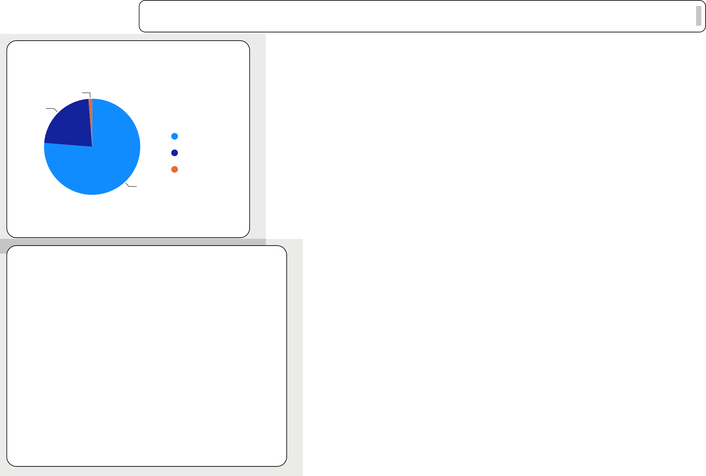
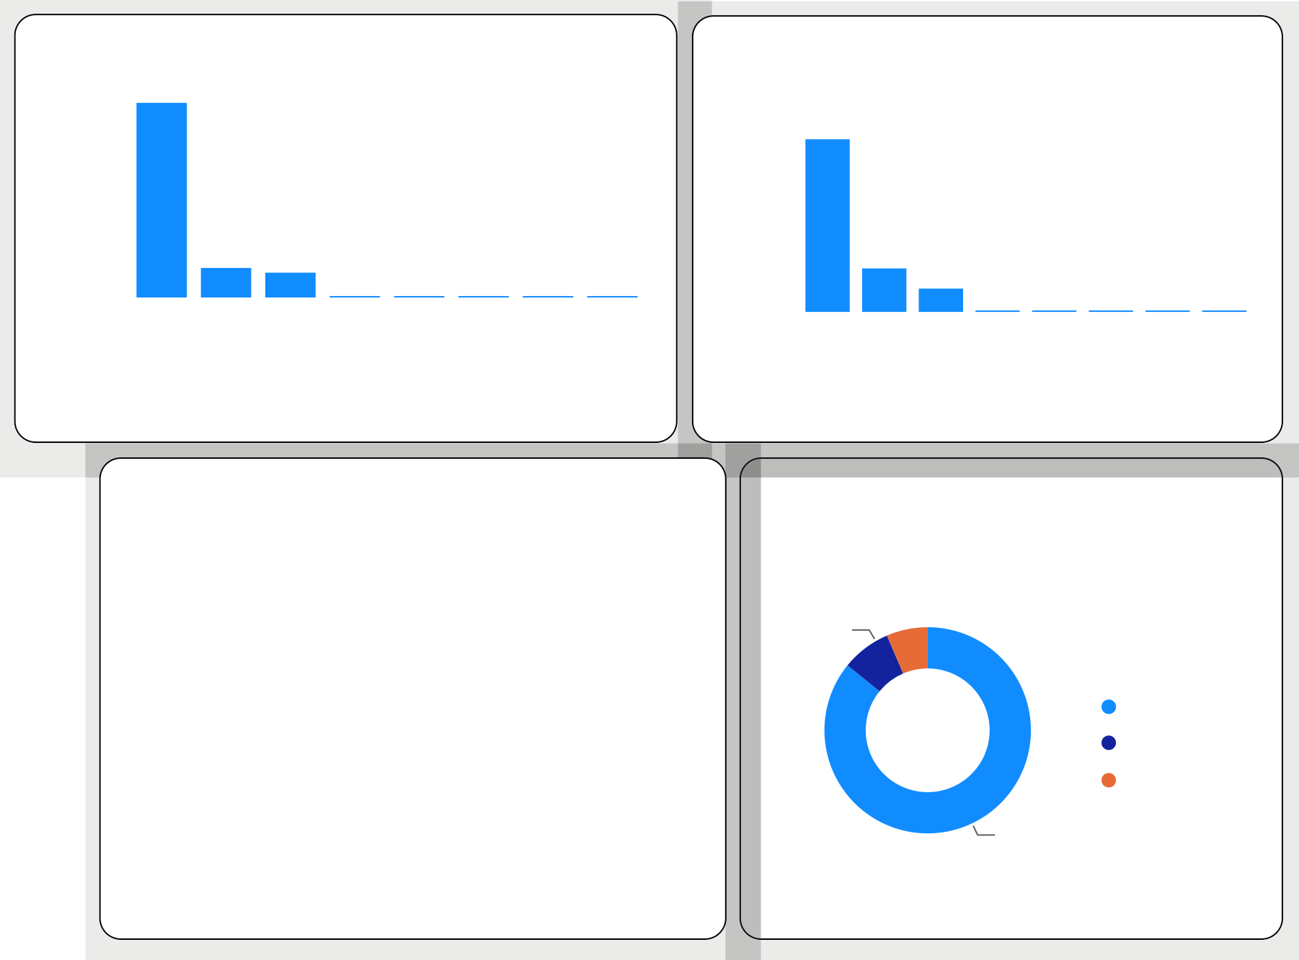
HOST PERFORMANCE
Power BI Desktop
host_is_superhost
host_verifications
10.4K
Count of host_acceptance_rate by host_verifications
17K
1.22%
Count of host_id
Count of host_acceptance_ra…
22.51%
host_is_superh…
f
t
1.6K
1.3K
4K
2K
0.0K
0.0K
0.0K
0.0K
0.0K
0K 0K 0K 0K 0K
76.27%
['phone']
['email']
[]
None
[]
['email', 'phone']
['phone', 'work_…
['phone']
['email']
None
['email', 'phone'…
['email', 'work_e…
['email', 'ph…
['email', 'ph…
['phone', 'w…
['email', 'wor…
host_verifications
host_verifications
host_response_time
Sum of review_scores_rating by host_response_time
Sum of host_total_listings_count by host_is_superhost
N/A
6.1K
within an hour
50K
host_response_time
within an hour
5.2K
88K (7.7%)
host_response_time
N/A
24K
within a few ho…
1.1K
host_is_superhost
f
t
within a few ho…
8K
within a day
0.8K
within a day
4K
a few days or …
0.3K
a few days or m… 1K
977K
(85.84%)
0.0K
0K
Count of host_id
Sum of review_scores_rating

Slide 9
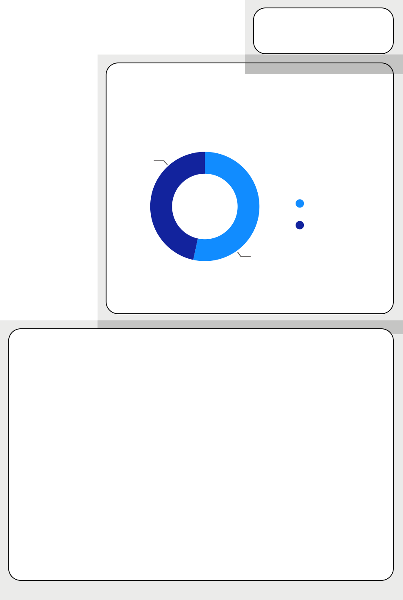
SCORES AND GUEST SATISFACTION
Power BI Desktop
avg review score
4.64
Sum of host_total_listings_count by review_scores_value
Average of review_scores_rating by has_availability
Sum of host_total_listings_count
101K
73K
4.1 (46.5…)
62K
has_availability
t
f
35K
26K
2K
3K
4.7
(53.42%)
0K
0
0K 0K 0K
4
0K
0K
5
1
2
review_scores_value
3
Average of review_scores_value by host_is_superhost
Sum of review_scores_location by name
Average of review_scores_value
4.8
Rental unit in Me… Rental unit in Me… Rental unit in Me… Rental unit in So… Rental unit in Me… Rental unit in So… Rental unit in St … Rental unit in Me… Rental unit in St … Rental unit in Me… Rental unit in Me…
334
4.6
4.6
269
209
190
name
144
144
140
139
136
163
t
f
128
host_is_superhost
Sum of review_scores_location

Slide 10
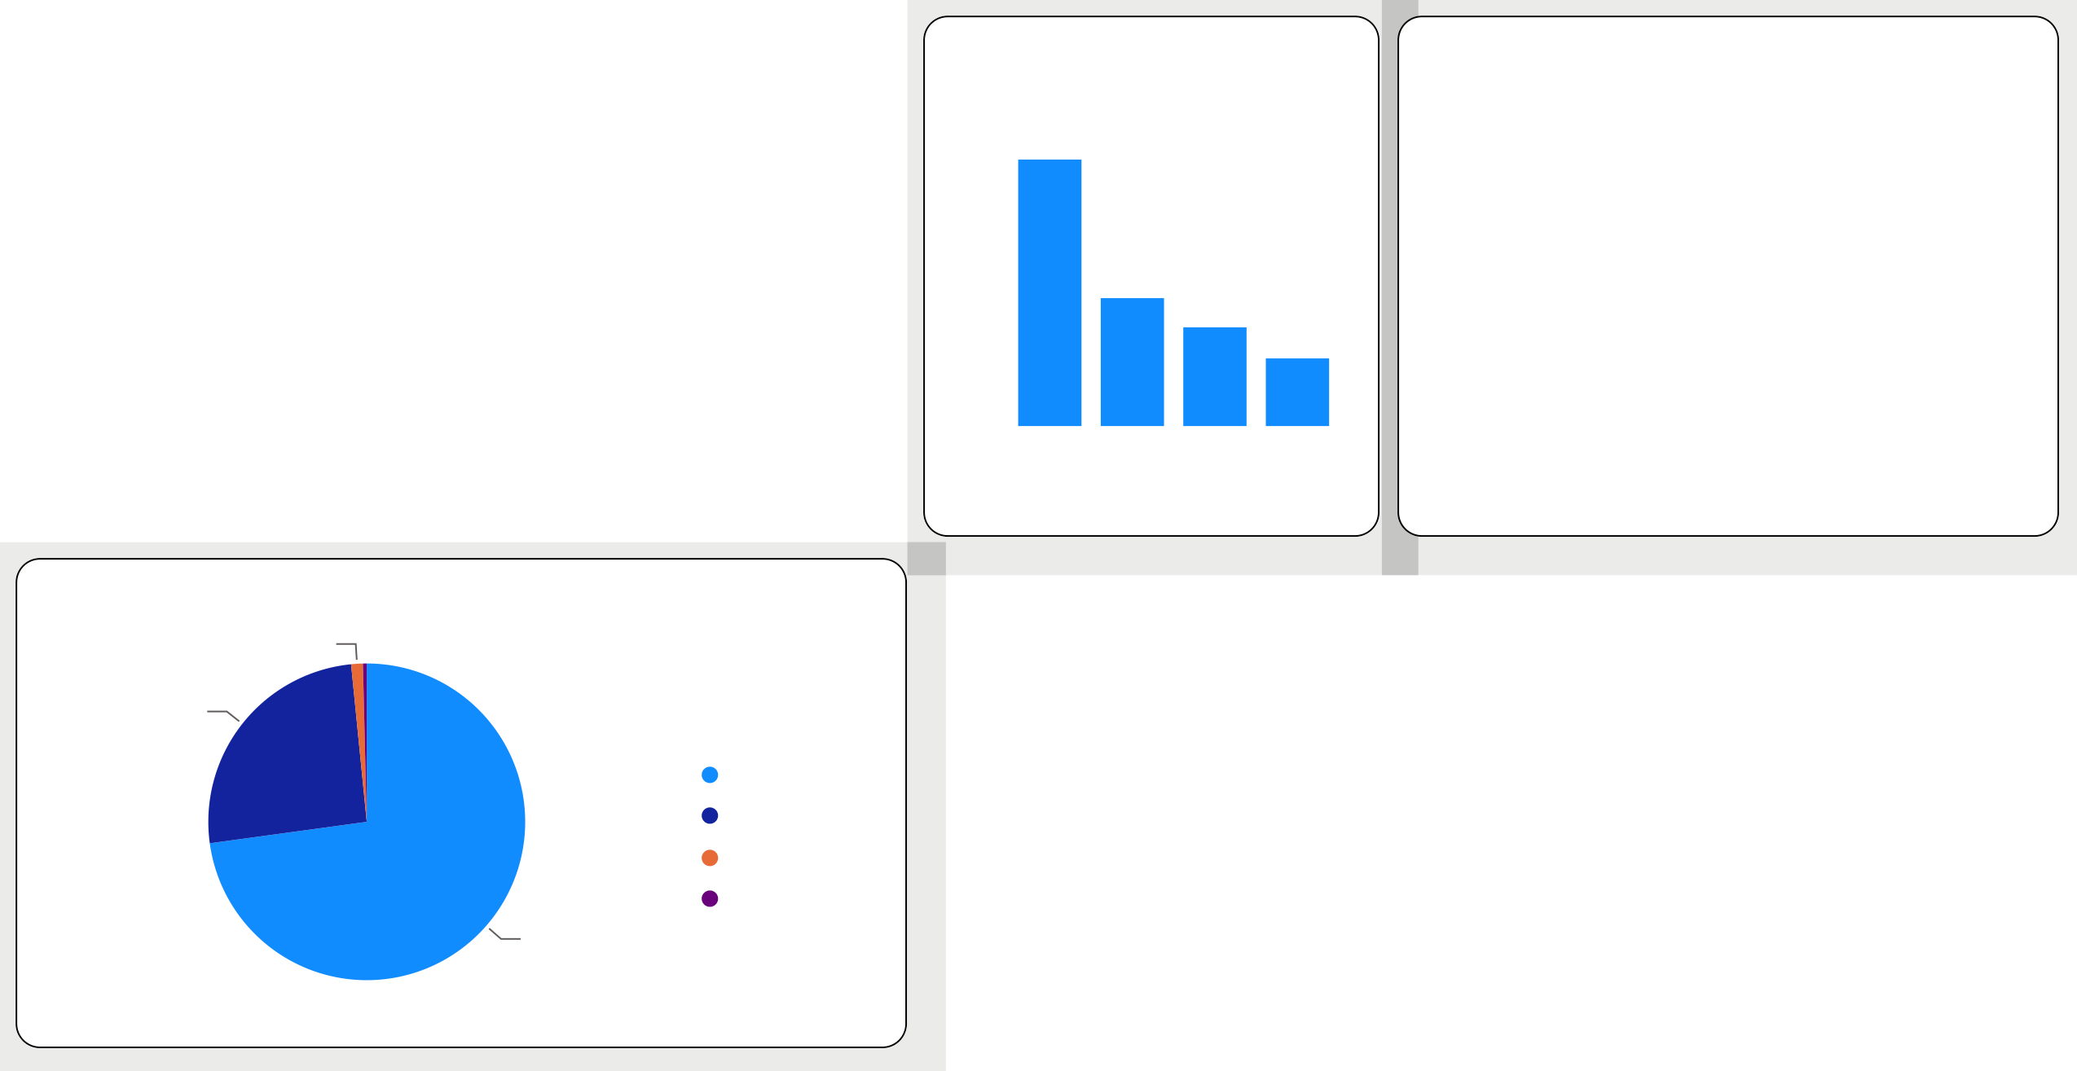
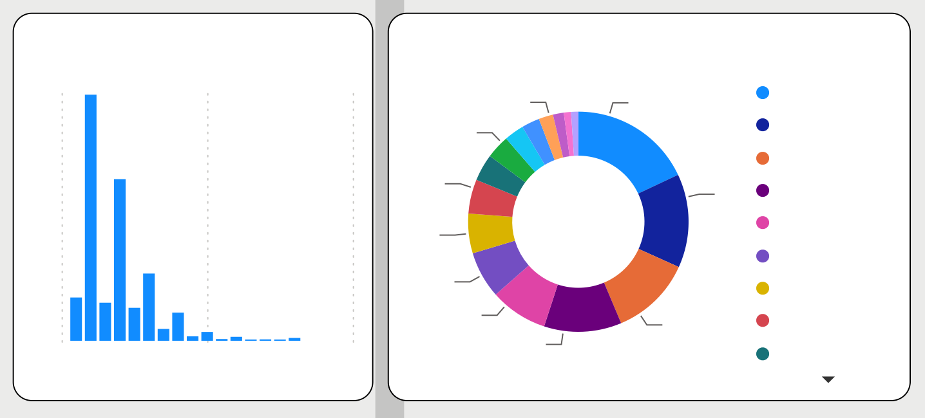
PROPERTY TYPE AND ROOM ANALYSIS
Power BI Desktop
distribution of property_type
Average of reviews_per_month by room_type
Average of reviews_per_month by property_type
Entire rental unit Entire home
Private room in home Private room in renta…
Entire condo Entire townhouse Entire serviced apart… Private room in town… Entire guesthouse Entire guest suite Entire cottage
Private room in condo
9.9K
3.6K
Average of reviews_per_mo…
1.57
Average of reviews_p…
4.1 _{3.8}
2.8K
3.4 3.4
1.7K
2.8 _{2.6 2.5 2.3}
property_type
0.8K
0.6K
^{2.1} 2.0 2.0 2.0 2.0 _{1.8 1.8 1.8}
0.5K
0.4K
0.4K
0.3K
0.75
1.7
0.58
0.40
Hut
Tent Bus
Tiny home
Barn Train Farm stay
Entire co… Camper/RV Entire loft Entire gu… Entire gu… Shared ro… Entire vac… Entire pla… Entire cab…
Dome
0.2K
0.2K
Entire home/…
Private Shared room room
room_type
Hotel room
Count of property_type
property_type
distribution of room_type
0.28K (1.19%)
Count of review_scores_value by accommodates
6.9K
Count of property_type by accommodates
accommodates
Count of review_scores_value
8 | 68 |  | 2
₁₃ (2.12%) (3.44%) 19 (5.…) 22 | (17.99%) | 52 (1…) | 4 1 3 6
(5.…) 26 (6.8…) |  |  | 5 8
32 (8.…) 43 (11.38%) | 45 (11.9%) |  | 7 10
5.93K (25.59%)
room_type
Entire home/apt
Private room
Shared room Hotel room
4.6K
1.2K_{1.1K}
16.89K (72.84%)
0.1K
0
10
accommodates
20

Slide 11
RECOMMENDATIONS FOR HOST

Slide 12
✓ Response Time: Host’s should improve their response time to as early as possible to ensure guest satisfaction as review scores by clients are high for host’s that respond on time. ✓ Pricing: hosts can adjust their prices according to the room type, accommodation capacity and property type based on the pricing analysis. They can also consider increasing prices for accommodations that can accommodate larger groups. ✓ Availability: Hosts can optimize their availability by analyzing the count of availability for different time period. ✓ Superhost Status: Hosts can aim to achieve the superhost status as it is associated with higher guest satisfaction. Hosts can focus on providing exceptional hospitability and meeting the criteria of for superhost status.

Slide 13
✓ Review and Rating System: The platform can continue to emphasize the importance of reviews and ratings for both guests and hosts. ✓ Pricing Insights: the aggregator platform can provide pricing insights to hosts to help them optimize their pricing strategies. This can include average pricing based on room type, among others. ✓ Availability Management: The platform can offer tools and features to help hosts manage their availability effectively.
RECOMMENDATIONS FOR THE AGGREGATOR PLATFORM

Slide 14
THANK YOU

